Slide 1
Subqueries

Slide 2
Retrieving data by using subquery as a source
select department_name,city
from DEPARTMENTS
natural join (select l.location_id, l.city, l.country_id
from locations l
join countries c
on(l.country_id= c.country_id)
join regions using (region_id)
where region_name= 'Europe');

Slide 3
A subquery in the from clause of a select statement is called an inline view.
A subquery in the from clause of a select statement define the data source of that particular select statement .
When a database view is created , the associated select statement is stored in the data dictionary.
With inline views all the code needed the support the query is in one place.

Slide 4
Multiple columns subqueries
Each row of the main query is compared to values from a multiple-row and multiple-column subquery.

Slide 5

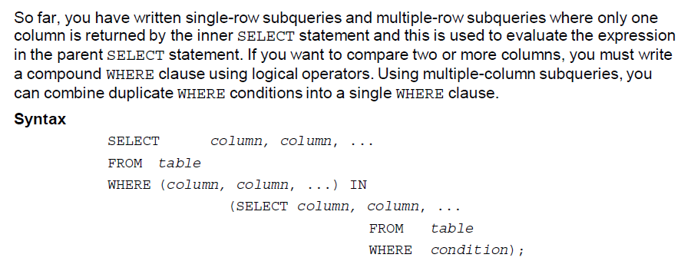

Slide 6
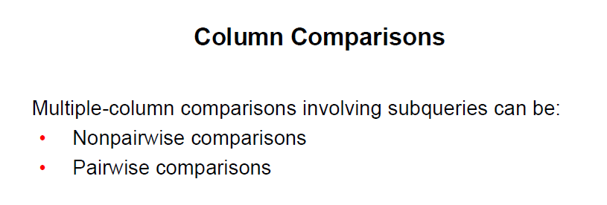

Slide 7
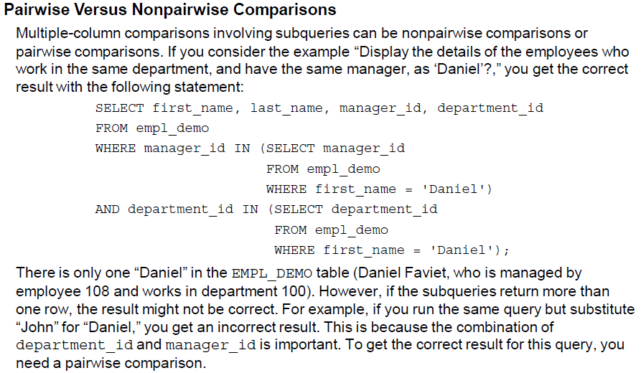

Slide 8
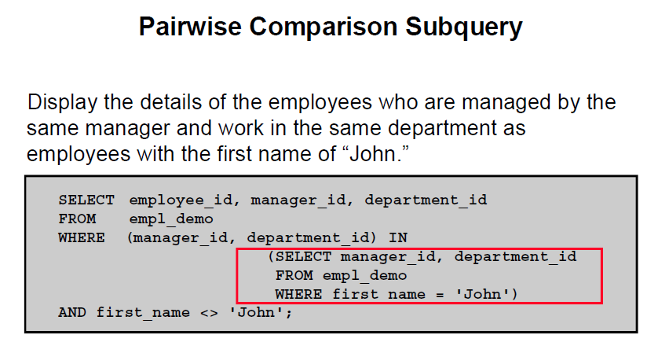

Slide 9
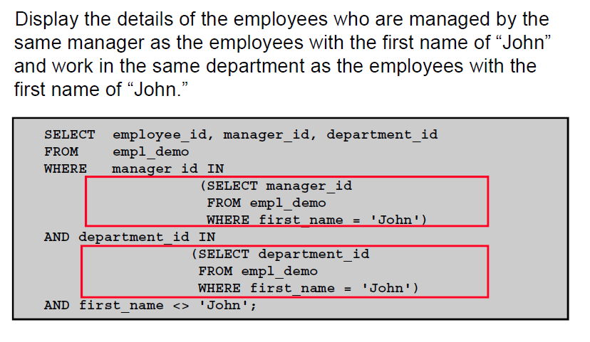
Non pairwise Comparison Subqueries

Slide 10
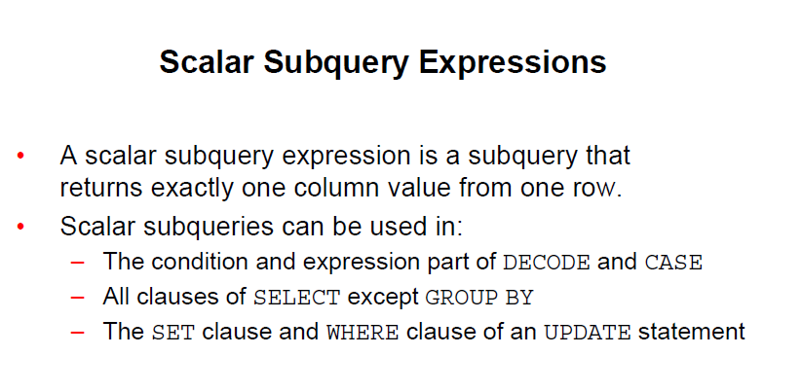

Slide 11
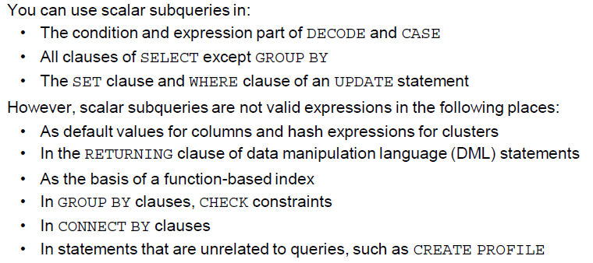

Slide 12
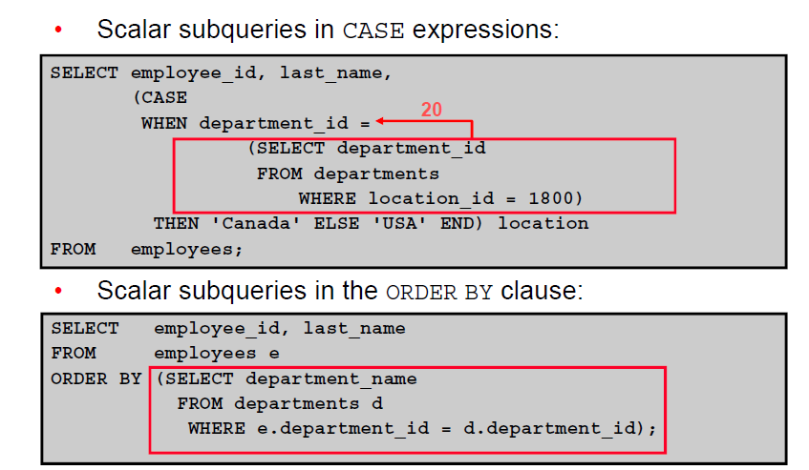

Slide 13
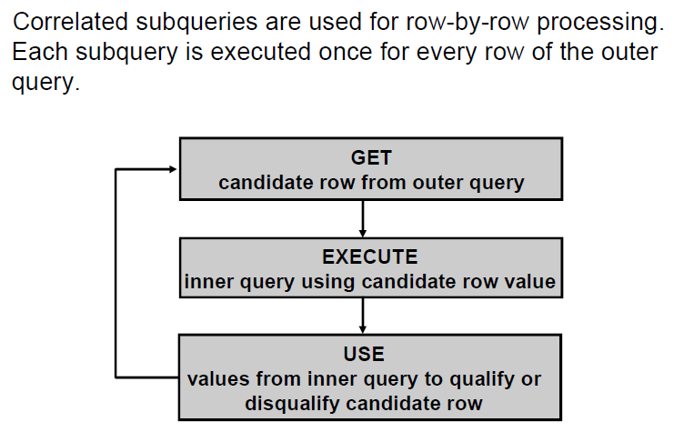
Correlated Subqueries

Slide 14
Correlated subqueries are performed when, the subquery references a column from a table referred in the parent statement.
A correlated subquery is evaluated once for for each row processed by the parent statement.
Parent statement can be select, update or delete.

Slide 15
Nested v/s correlated subqueries
In nested subquery: the values returned by the inner select are used by the outer query.
A correlated subquery executed once for each candidate row considered by the outer query. i.e outer query drives inner query.
  Any and all are used in correlated subqueries.

Slide 16
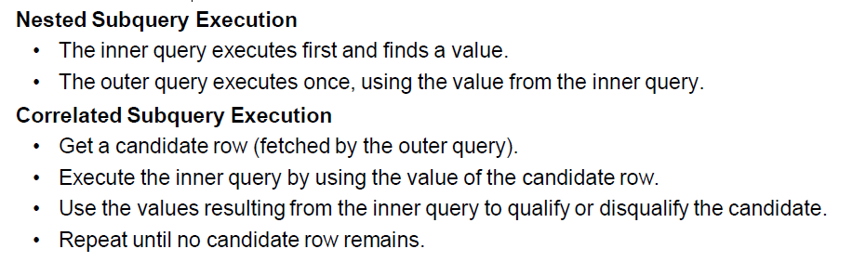

Slide 17
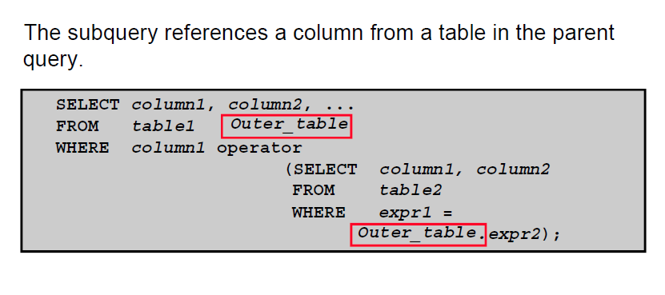
Correlated subquery

Slide 18
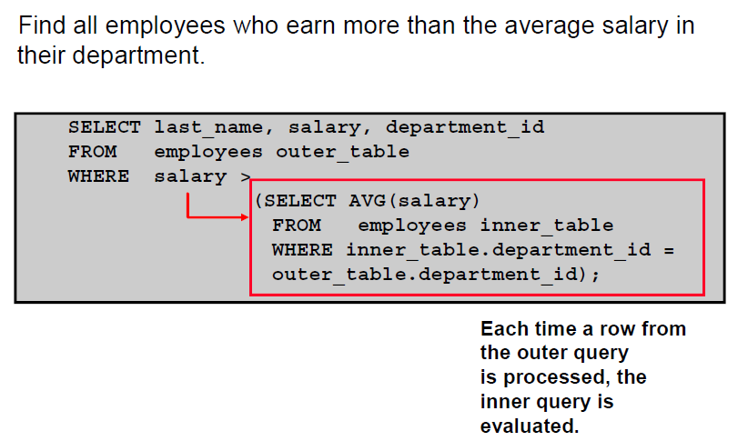
Using correlated subquery

Slide 19
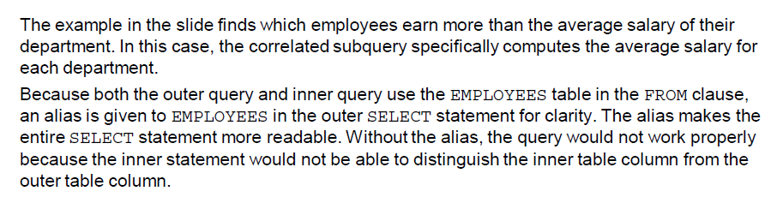

Slide 20
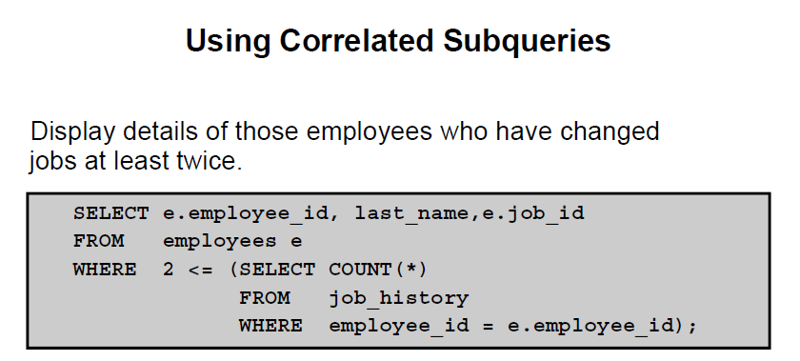

Slide 21
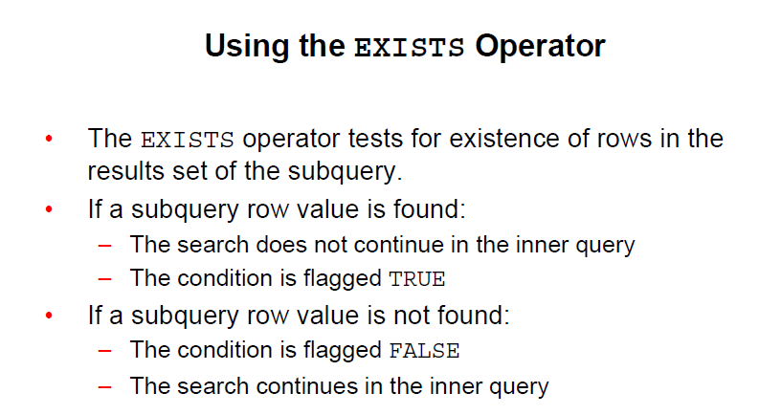
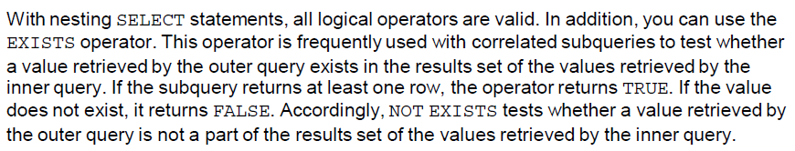

Slide 22
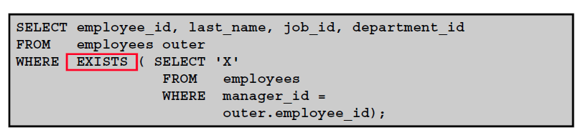

Slide 23
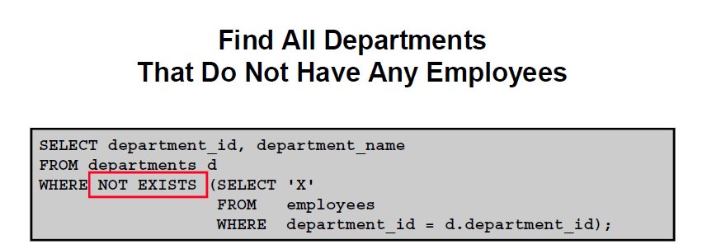

Slide 24
ALL & ANY

Slide 25
All exists and any
select * from employee where salary > all(select salary from boss);
select * from employee where salary > any(select salary from boss);
insert into boss values (7,'Mike','Ross', 10000);
select * from employee where exists(select salary from boss where salary > 60000);
INSERT INTO contacts (contact_id, contact_name) SELECT supplier_id, supplier_name FROM suppliers WHERE EXISTS (SELECT * FROM orders WHERE suppliers.supplier_id = orders.supplier_id);

Slide 26
UPDATE suppliers SET supplier_name = (SELECT customers.name FROM customers WHERE customers.customer_id = suppliers.supplier_id) WHERE EXISTS (SELECT customers.name FROM customers WHERE customers.customer_id = suppliers.supplier_id);

Slide 27
DELETE FROM contacts WHERE EXISTS (SELECT * FROM employees WHERE employees.last_name = contacts.last_name);

Slide 28
WITH CLAUSE
With the WITH Clause you can define a query block before using it.
It is also known as the “subquery factoring block”.
Enables you to use the same query block if it is used more than once in a complex query.
The results are retrieved and stored in the users temporary table space.
It improves performance.

Slide 29
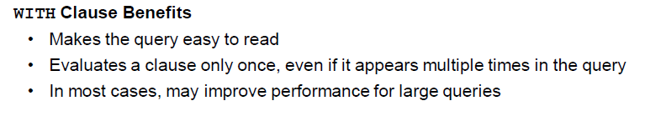

Slide 30
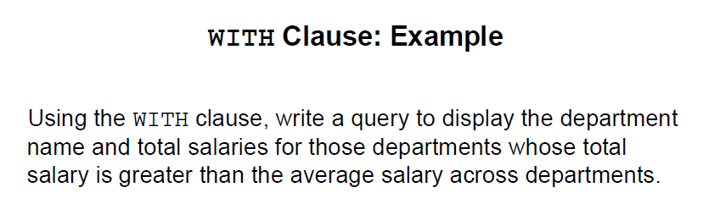
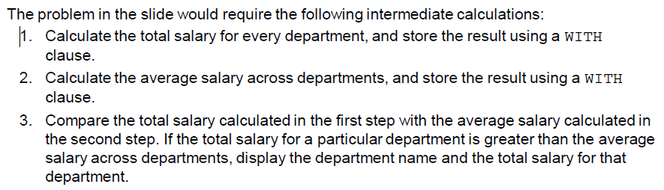

Slide 31
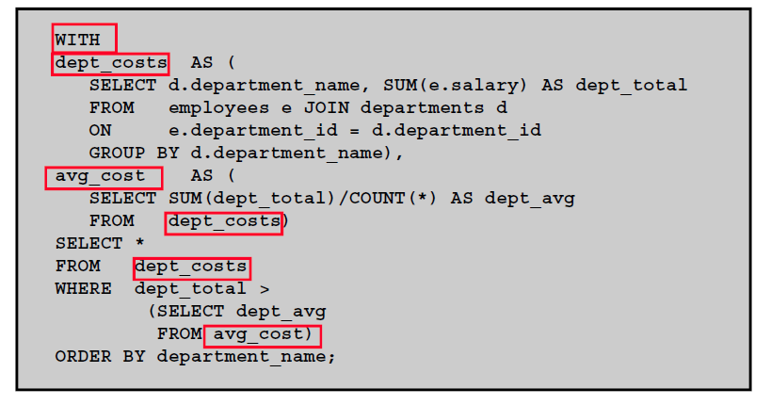
solution

Slide 32
